Slide 1
Sustainable Finance Analysis of Zijin Mining Group
Group 9 | Jiayi Tu | 2036063
 | Haoyu Xu | 2034242
 | Jiawen Zhou | 2034040
 | Chenzhe Zhang | 2035754
 | Xiyue Zhang | 2035178

Slide 2
Outline
Overview
ESG Practices
Accountability & Reliability of the Self-Reported Information
Relevance of the Claimed ESG goals
Financial Analysis
Conclusion

Slide 3
Overview
Zijin Mining: a prominent player in the Chinese mining industry
A solid risk-return profile in China
But...
Lacking ESG performance → a higher risk perception

Slide 4
ESG Practices —— key achievements
ESG — Environment (E)
Total greenhouse gas emissions 7.26 million tCO2e Greenhouse gas emissions intensity 32.25 tCO2e/ RMB million revenue, down 9.49% year-on-year
Renewable energy ratio is 2.3%, up 1.32% year-on-year
Water re-use rate 92.02%
SO2 emissions intensity reduced by 15.95% year-on-year, NOX emissions intensity reduced by 11.96% year-on-year
Restored 7.756 million square metres of land, all restorable land in this year has been restored

Slide 5
ESG Practices —— key achievements
ESG — Scoiety (S)
Using 2019 LTIR as the benchmark, lower 2022 LTIR by 30% (LTIR 0.30)
Using 2019 TRIR as the benchmark, lower 2022 TRIR by 30% (TRIR 0.68)
Maintain employee and contractor safety training rate at 100%: 100% of employees and contractors received safety training with an average of 5.0 training sessions received per employee and contractor
Committed to invest 1% of profit for every financial year: A total of RMB424 million (1.68% of the profit) was invested in communities

Slide 6
ESG Practices —— key achievements
ESG — Governance (G)
Continuously improve Board diversity: ratio of female in the Board 7.7%
Continuously improve Board independence: ratio of non-executive director and independent directors 53.8% (Audit and Internal Control Committee)
Increase Board’s influence on ESG management: 30% of the proposals considered and approved by the Board related to ESG issues
Establish a sound ESG risk management system: key ESG risks have been preliminarily identified

Slide 7
ESG Practices —— potential risks
Geopolitical risk
Environmental risk
Market risk
Climate change risk
Human rights risk

Slide 8

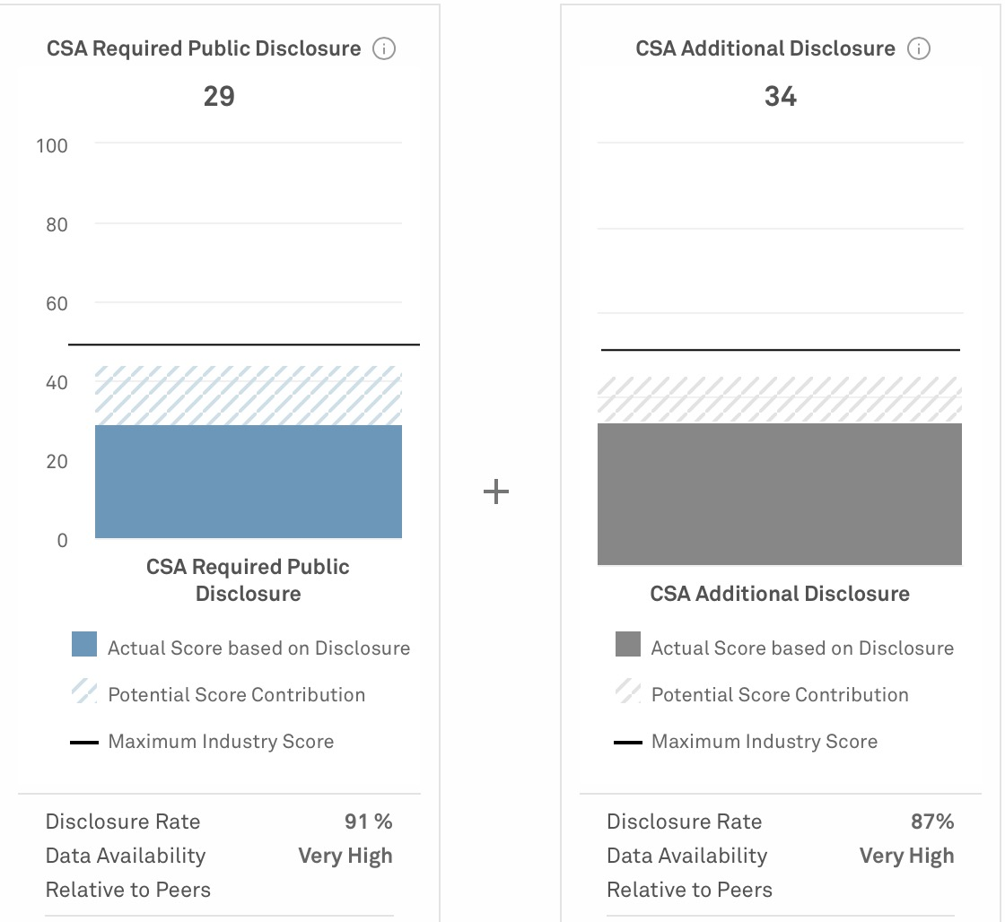
Accountability & Reliability of the Self-Reported Information
In general, Zijin Mining's ESG report is credible.
Disclosure rate data & availability compared to peers are rated relatively high.
ISO 14001 & ISO 45001certifcation coverage→87.5%
Source: S&P Global

Slide 9
Accountability & Reliability of the Self-Reported Information
Ambiguous information
Insufficient details→ hard to tell the real efforts
E.g. innovated equipment and processes → improve water reuse rate
Specific innovation points and results?

Slide 10
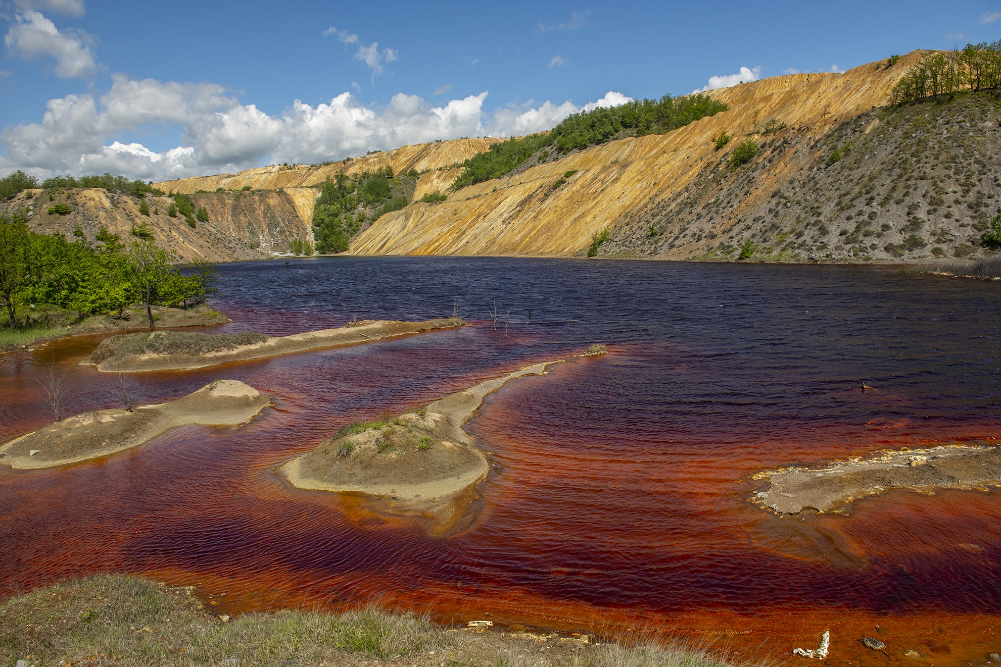
Accountability & Reliability of the Self-Reported Information
Selective disclosure
According to the report,
Water discharge volume and intensity increased in 2021
Attributed the increase mainly to the high rainfall at the mines located in South America
However…
Suspended by Serbia government due to environmental standard violations
Mandated to construct a wastewater treatment plant

Slide 11
Accountability & Reliability of the Self-Reported Information
Selective disclosure
According to the report,
Conduct environmental impact assessment in accordance with local the laws and regulations of the country (region)
Investigate and assess the adverse impacts and risks on the surrounding environment throughout the life cycle of the project
Formulate reasonable risk response measures to lower and eliminate any possible adverse impacts
However…
Without necessary permits, local consent, or transparency, leading to significant environmental pollution, particularly in the village of Ostrelj and the city of Bor
Negatively affected lives and health of local residents and the environment
--Source: Just Finance

Slide 12
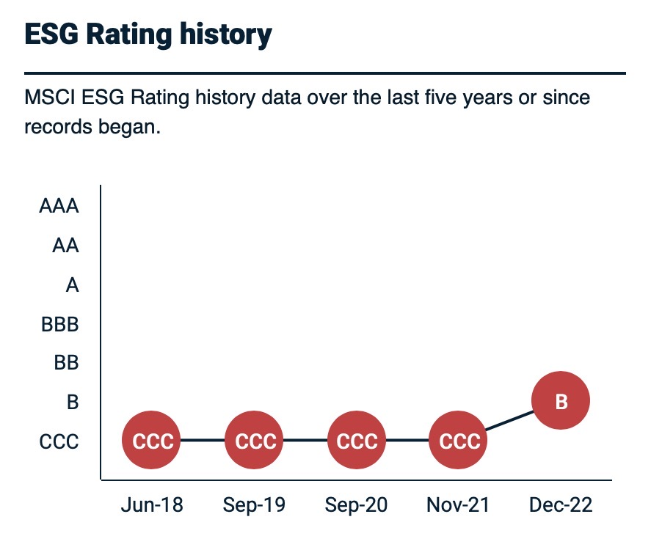


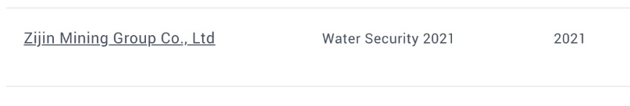

Accountability & Reliability of the Self-Reported Information
Third-Party Evaluation – Relative Low
CDP ESG Rating
MSCI ESG Rating

Slide 13
Relevance of the claimed ESG goals
Specific ESG Goals:
The company has set:
Short-term ESG goal: not explicitly listed
Medium-term ESG goal: achieve carbon peak by 2029
Long-term ESG goal: achieve carbon neutrality by 2059

Slide 14
Relevance of the claimed ESG goals
Zijin Mining Group is roughly aligned with ESG goals
Zijin Mining aligns its activities with the United Nations Sustainable Development Goals (SDGs)→a focus on broader societal and environmental objectives
They have clear strategies and practices in line with these goals:
reducing greenhouse gas emissions
promoting renewable energy
ensuring high standards of environmental protection

Slide 15
Financial Analysis
ZIJIN MINING(601899.SH) is the best in domestic mining industry;
We choose another mining company in the global stock market-FREEPORT MCMORAN (FCX.N) as the benchmark.
Since this two companies market values are almost the same.
Zijin:
FCX.N:
Source: Wind
Data time horizon:2017-2021(recent five years)

Slide 16
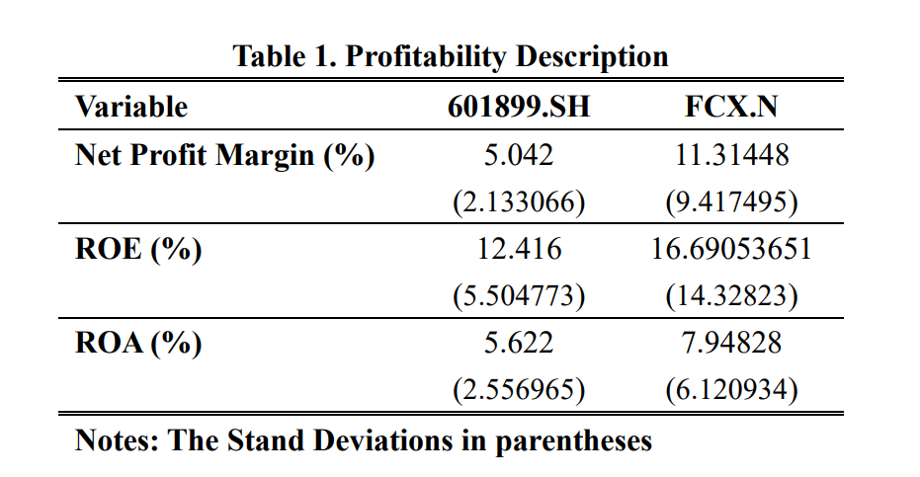
Financial Analysis-Profitability Ratios
The Net Profit Margin, ROA, and ROE of FREEPORT MCMORAN are both higher than Zijin on average.

Slide 17
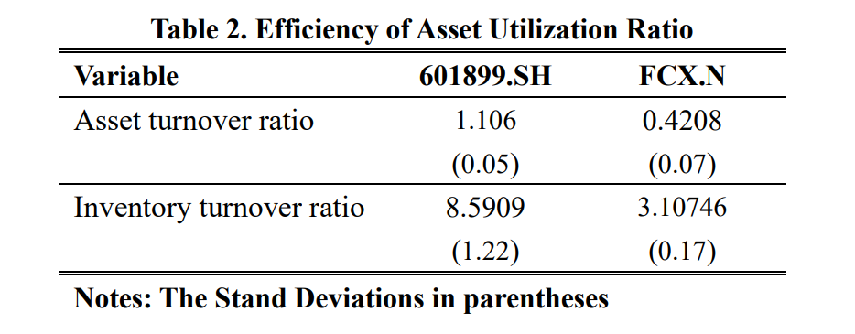
Financial Analysis-Efficiency of Asset Utilization Ratios
Zijin’s Efficiency of Using Asset is higher, but the stability shows no significant difference.

Slide 18
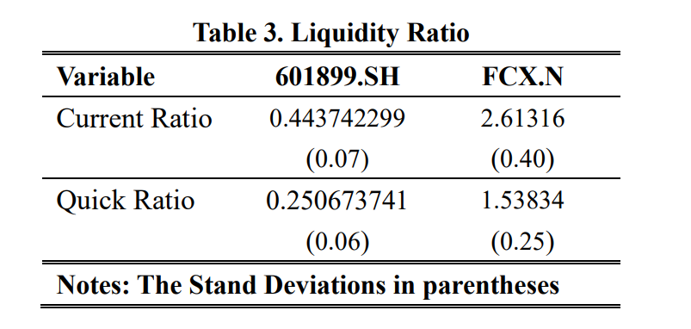
Financial Analysis-Liquidity Ratios
Zijin’s Short-term solvency is weak, and there may be a risk of cash flow difficulties or debt crisis.

Slide 19
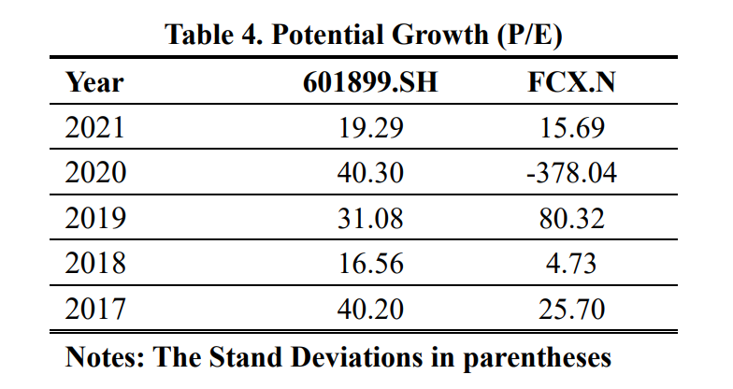
Financial Analysis-Market Price Ratios
Zijin is more stable and has a potential growth opportunity.

Slide 20
Financial Analysis-Economic Value Added
Zijin Mining's EVA turned from negative to positive, rather than all negative as Freeport McMorran

Slide 21
Financial Analysis-Final Suggestion
Zijin Mining is still a good option when comparing with mining company in global market.
The performance is more stable than FREEPORT MCMORAN;
Final choice depends on the risk-aversion attitude.
But overall, Zijin has outperformed benchmark company in most of these indices. This is a stock worthy of recommendation in terms of Financial analysis

Slide 22
Conclusion
Potential risks regarding the ESG strategies;
ESG practices;
Credibility of ESG practices:
Selection bias
Environmental pollution event has not been revealed.
Financial performance:
Relatively stable than FREEPORT MCMORAN

Slide 23
Conclusion
Zijin Mining may not be the best investing option;
ESG rating is too low
CCC in MSCI 2021
C for water security, and D for climate change in CDP 2021
ESG has a positive correlation with company performance (Chen, and Xie, 2022)
Better considering other mining companies with higher ESG.
Such as FREEPORT MCMORAN (BB in MSCI 2021)
Or ANGLO AMERICAN PLC (A in MSCI 2021)

Slide 24
Reference list
Chen, Z., & Xie, G. (2022). ESG disclosure and financial performance: Moderating role of ESG investors. International Review of Financial Analysis, 83, 102291.
MSCI ESG Rating (2023) Available at:
https://www.msci.com/our-solutions/esg-investing/esg-ratings-climate-search-tool/issuer/zijin-mining-group-company-limited/IID000000002190469
CDP ESG Rating (2023) Available at:
https://www.cdp.net/zh/responses?filters%5Bcountries%5D%5B%5D=China&filters%5Byears%5D%5B%5D=2021&filters%5Byears%5D%5B%5D=2022&filters%5Byears%5D%5B%5D=2023&per_page=10&queries%5Bname%5D=zijin&sort_by=project_year&sort_dir=desc

Slide 25
Reference list
Serbia halts China-owned mine over environmental breaches (2021) Available at:
https://www.reuters.com/business/environment/serbia-halts-china-owned-mine-over-environmental-breaches-2021-04-14/#:~:text=BELGRADE%2C%20April%2014%20%28Reuters%29%20,energy%20minister%20said%20on%20Wednesday
China’s Zijin Mining Polluting Serbian Village, Says Group (2022) Available at:
https://www.asiafinancial.com/chinas-zijin-mining-polluting-serbian-village-says-group#:~:text=The%20villagers%20are%20calling%20on,takes%20into%20account%20environmental%20impact
Data resources are all from Wind Database

Slide 26
Thanks for your listening

